Slide 2
ENCRYPTION WIZARD
FLWRAP W/FLDIGI
FLAMP W/FLDIGI
By AFA4II With Thanks to NNN0ASC

Slide 3
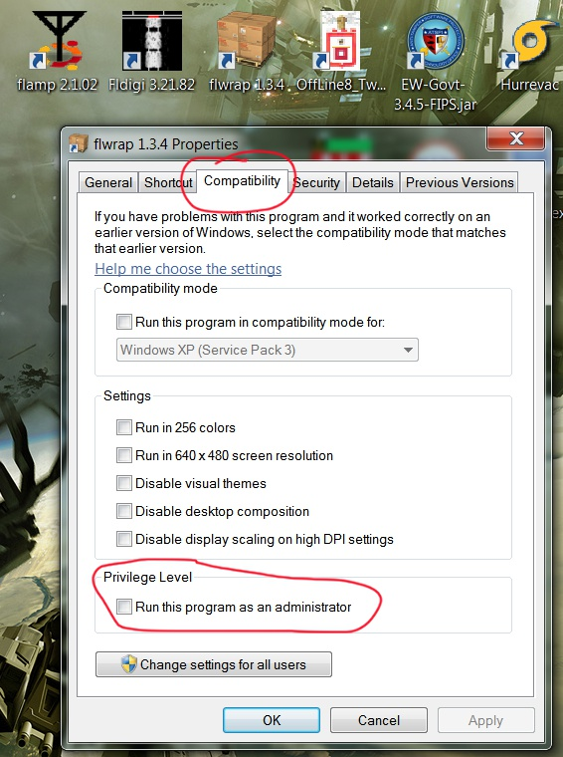
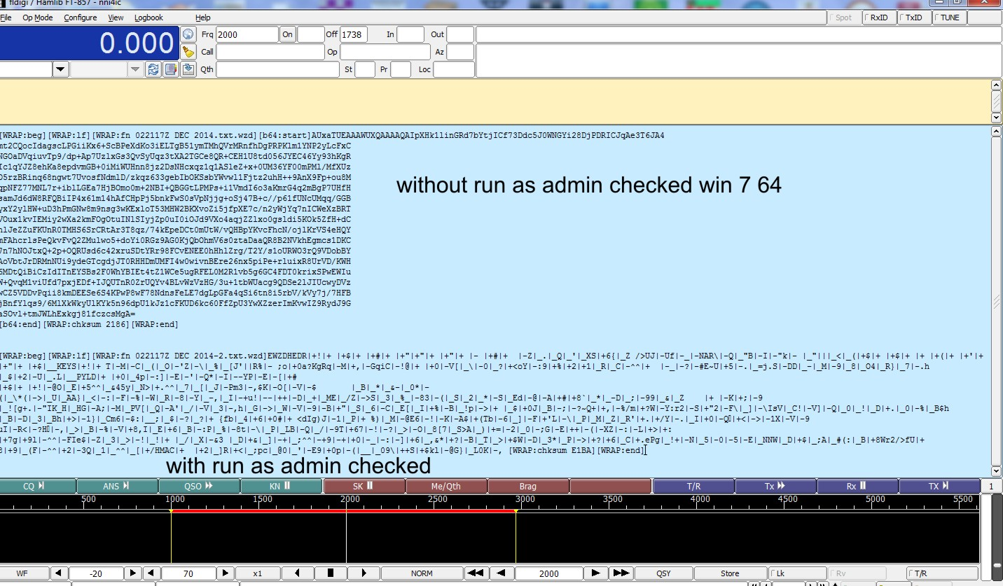
INSTALLING FLWRAP
WHEN INSTALLING FLWRAP MAKE SURE THAT YOU DON’T SELECT
“RUN AS ADMINISTRATOR”
IF YOU DO IT WILL CAUSE THE WRAP FILE TO BE CORRUPTED

Slide 4
How do I send an Encryption Wizard encrypted file by HF radio?
For now we have to use an INTERIM method,
which can be done in one of two ways
1. FLWRAP W/FLDIGI
2. FLAMP W/FLDIGI

Slide 5
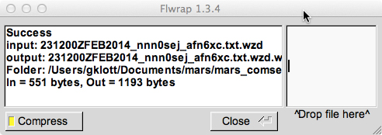
#1
FLWRAP W/ FLDIGI
Create message in a Text editor,
(not a word processor) & save as a .txt
Drag & drop into Encryption Wizard and Encrypt
Drag & drop the .WZD file into FLWRAP,
Ensure you check “Compress” in lower left

Slide 6
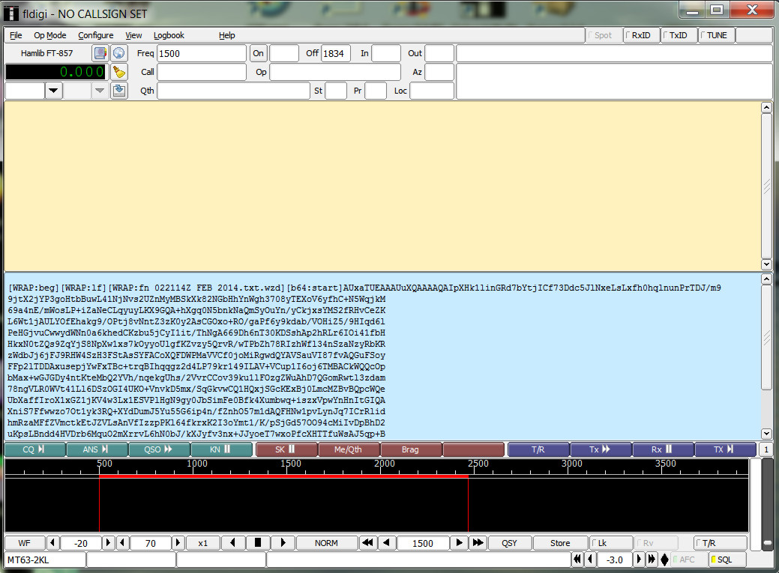
then drag & drop the WRAP file into FLDIGI & send your message

Slide 7
When receiving
a WRAP file
Reverse the process upon receive
In FLDIGI, select from [WRAP:beg] through [WRAP:end]
Name & save the file & add .WRAP. Ie: Received.txt.wrap (use text editor not word processor)
Drop .wrap file into FLWRAP
Drop .wzd file into EW - decrypt
Open .TXT file

Slide 8
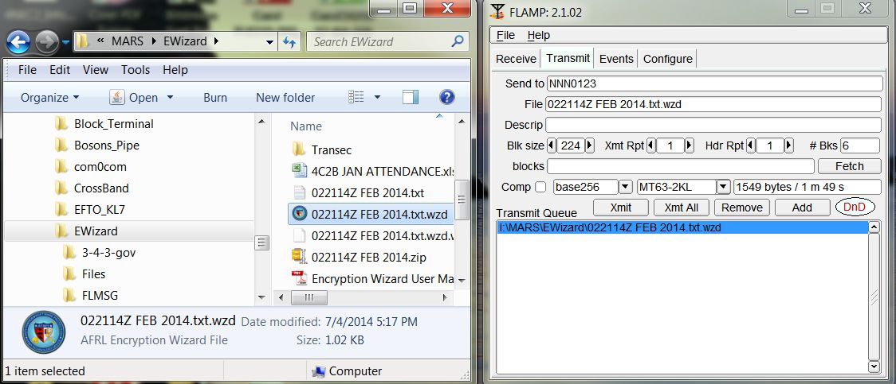
#2
FLAMP W/FLDIGI
FlAmp has the advantage of being able to send an encrypted file as is ie: a .wzd file.
You can drag & drop to the red DnD or you can click ADD
and browse to the file you want to send. There is no wrapping or unwrapping involved

Slide 9
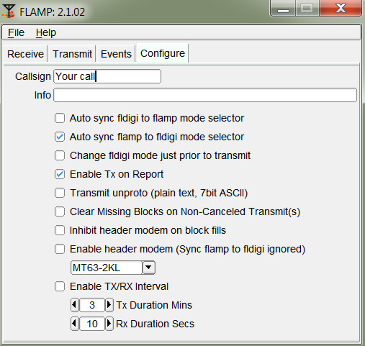
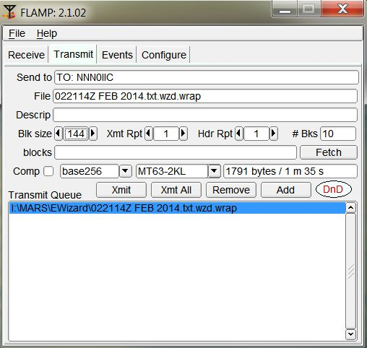
#2
FLAMP W/FLDIGI
First, configure FLAMP, fig 1
FLAMP has several key features.
1. Sends the file as blocks, with no stopping & restarting like block term no sync to lose.
2. You can change the block size to control the # of blocks
3. Sending station can fill a missing block to multiple stations at one time.
Put in your call sign,
Then only check these boxes
Transmit Screen
Fig 1

Slide 10
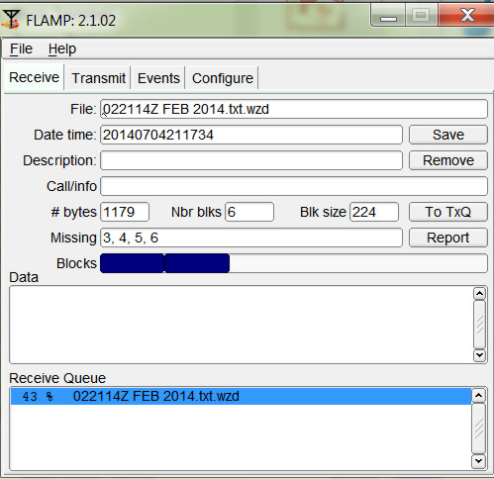
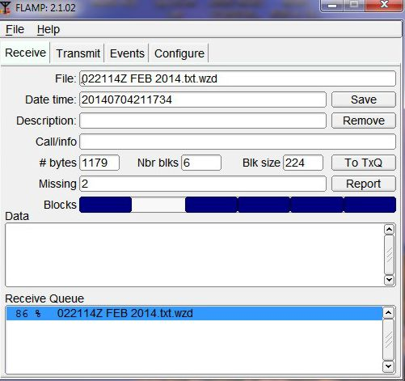
When receiving a file you will see the # of
blocks.
As each block is received it will show on the blocks line.
Any missing blocks will be shown on the missing line
At the end of transmission any station missing a block or blocks will so state when it is their turn to rgr the msg,
ie: de nni4ic missing block 2, over
In turn, stations missing a block will click on Report, after all stations missing blocks have reported, the sending station clicks on FETCH

Slide 11
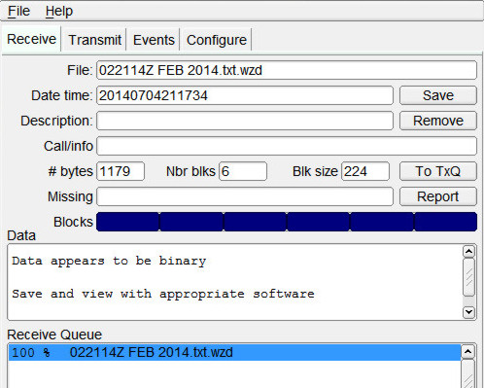
Flamp parses all of the received data from one or more reporting stations. It combines them, discards duplicates and sorts the missing blocks numerically. It then updates the "blocks" entry control with the requested blocks. Missing header information assigns '1' to the missing block list, triggering a retransmission of the header information.
The combined set of missing blocks will appear as shown below along with total file size and transmission time.
Fig 1
After any missing blocks or header info has been resent your receive window will look like this: (fig 1)
The Data window tells you that you need to save and view with the appropiate program

Slide 12
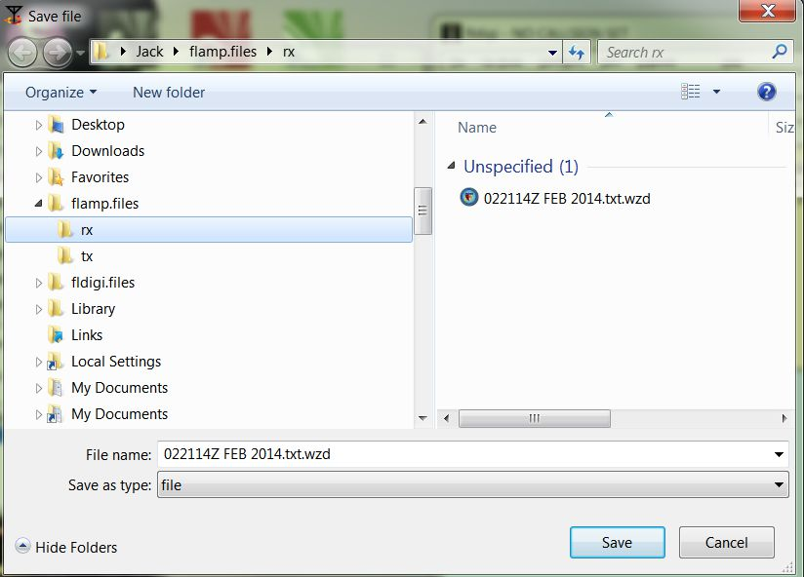
When you click SAVE the FLAMP Rx folder opens, save the file, then drag & drop into Encryption Wizard and decrypt.

