Slide 1
Left click to advance

Slide 2
ENCRYPTION WIZARD
MARS COMSEC Crypto Keys
&
KEYCHAINS
By AFA4II With videos By NNN0ASC

Slide 3
Youtube video
What are
MARS COMSEC Crypto Keys
Passphrases & Keychains

Slide 4
“KEYCHAINS”
What are they?
Do I need one?
How do I make
A Keychain?

Slide 5
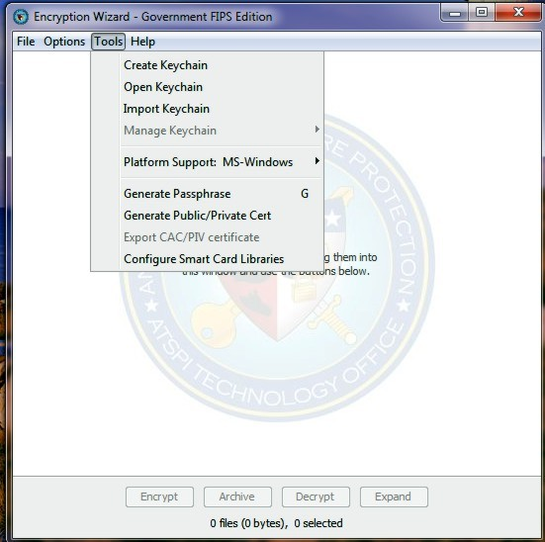
Encryption Wizard will be using a variety of 10 digit Passphrases
that can consist of any character on your keyboard,
ie: 0.f0C_cs.H This complex set can easily lead to making an
error when typing in an encryption or decryption passphrase.
The use of keychains can alleviate this problem.
Open EW and click tools, create keychain.

Slide 6
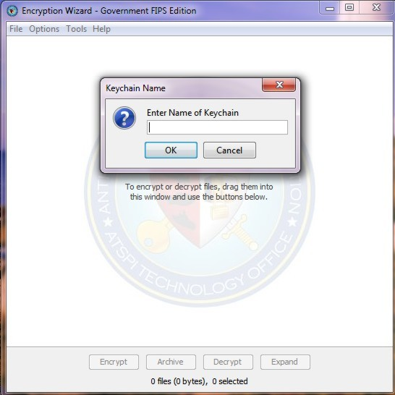
Next give the keychain a name,
You can have multiple keychains as long as each has a different name.
newChain

Slide 7
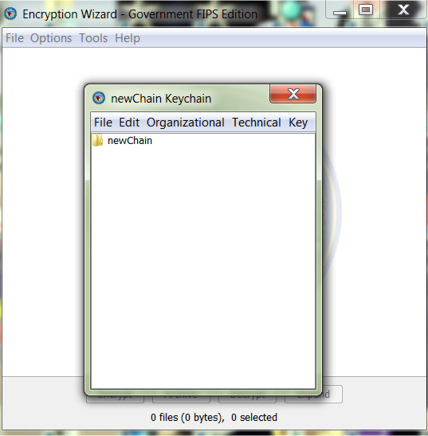
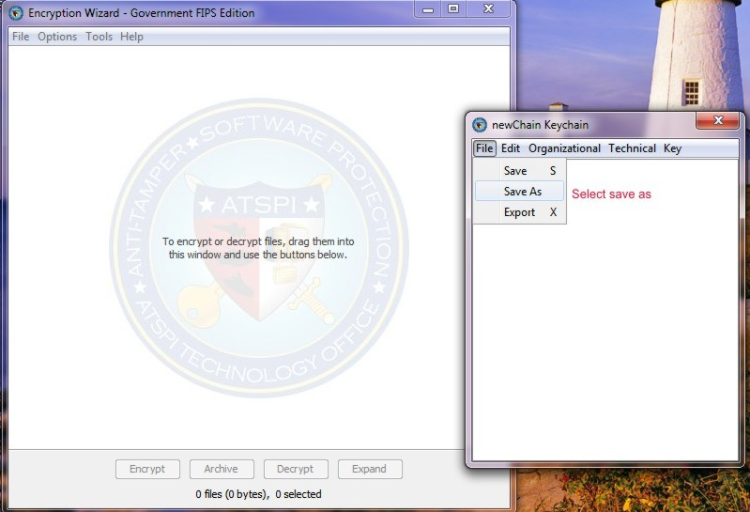
The next thing is to save your keychain
Click File, Save As
New Keychain

Slide 8
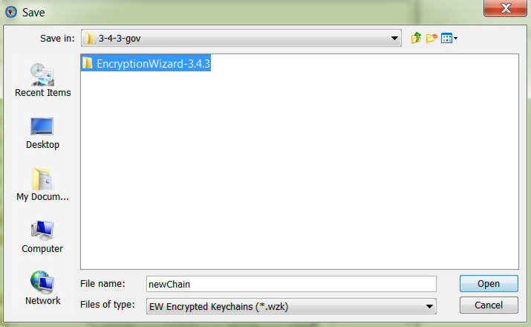
You can save the keychain two ways, if you want to be prompted to open
Your keychain each time you open EW then save it in the folder where
Your EW .jar file is.
If you don’t want to be prompted, save in a sub-folder.

Slide 9
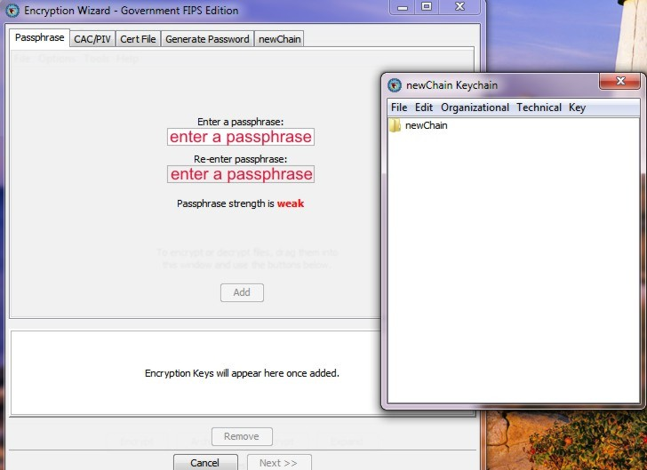
After saving, the enter a passphrase window opens,
what you put here is the passphrase for your Keychain,
If you don’t enter a passphrase you will not be
able to open your keychain.

Slide 10
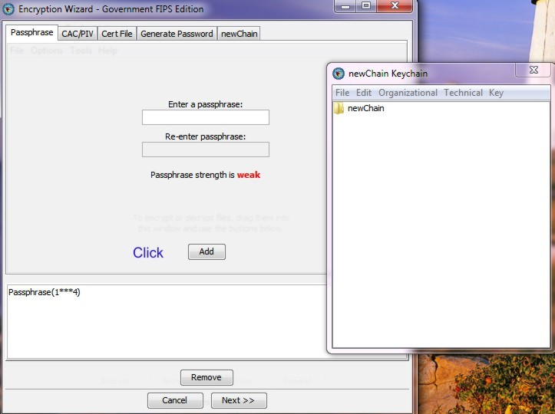
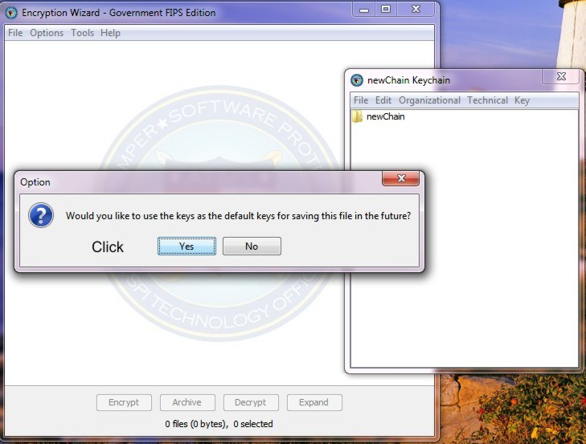
1. Click ADD
2. Then click next
3. Click YES

Slide 11
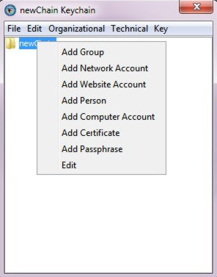
Now that you have created, pass worded & saved your Keychain
You can start adding your groups & their passphrase’s.
Right click the keychain folder, then click ADD GROUP

Slide 12
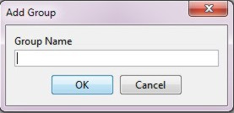
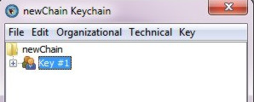
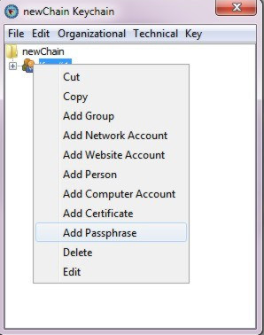
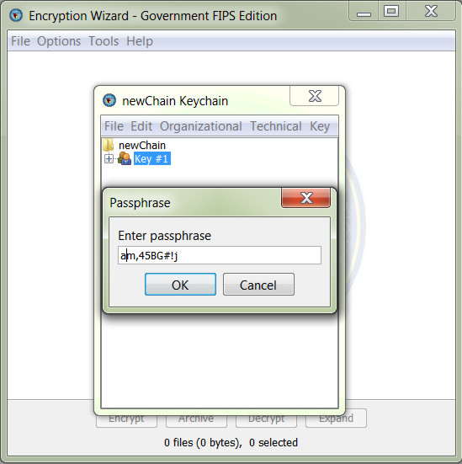
1. Name the Group, click OK. 2. Then right click the new group
3. Select Add Passphrase, 4. copy your passphrase from notepad
& paste into enter passphrase box, click ok
1
2
Key #1
3
4

Slide 13
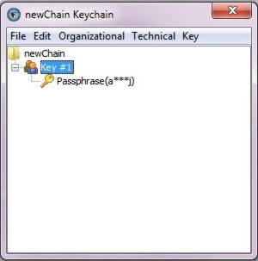
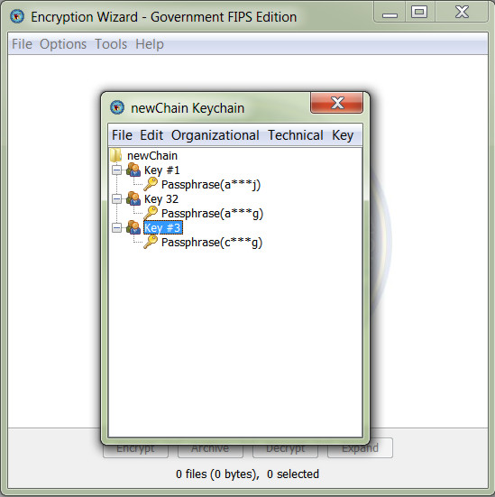
Follow the same procedure to add more groups and passphrases

Slide 14
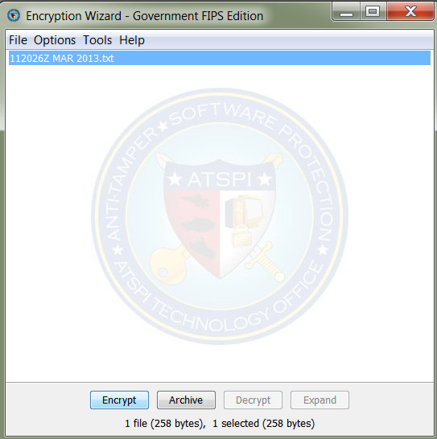
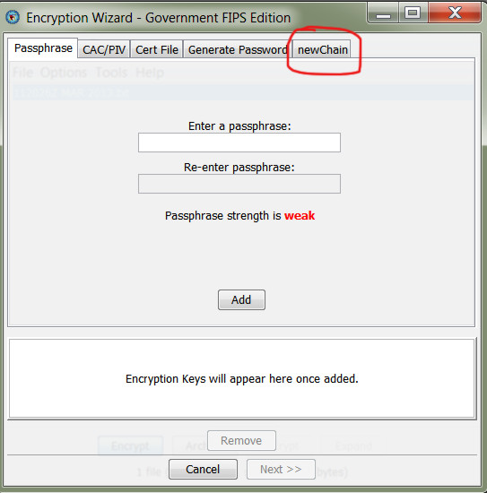
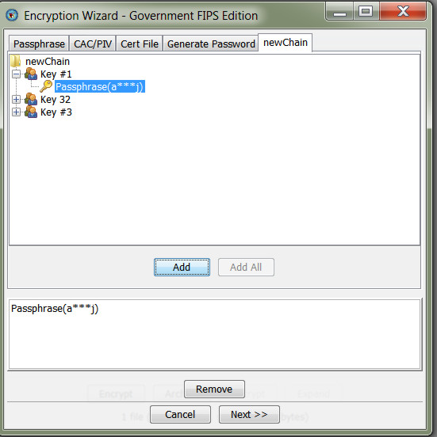
To encrypt with a
passphrase
1. Drag & drop the file into EW
2.Click your keychain tab
3. Select the passphrase that you want to use,
click ADD & then NEXT
1
2
3

Slide 15
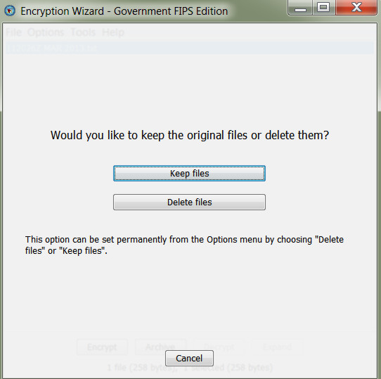
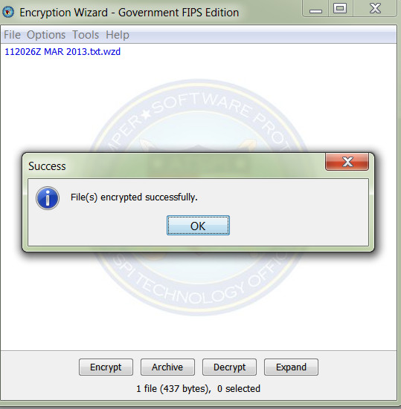
4. You can either keep or delete the original file, suggest keep
5. You now have an encrypted file
To Decrypt just reverse the order.
No more hand typing passphrases
4
5

