Slide 2
Encryption
WIZARD
INSTALLING ENCRYPTION WIZARD
By AFA4II

Slide 3
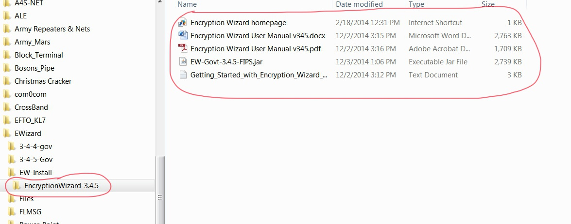
Create a folder for EW. ie C:/EncryptionWizard-3.4.5
Download the EW zip file & unzip to this folder

Slide 4
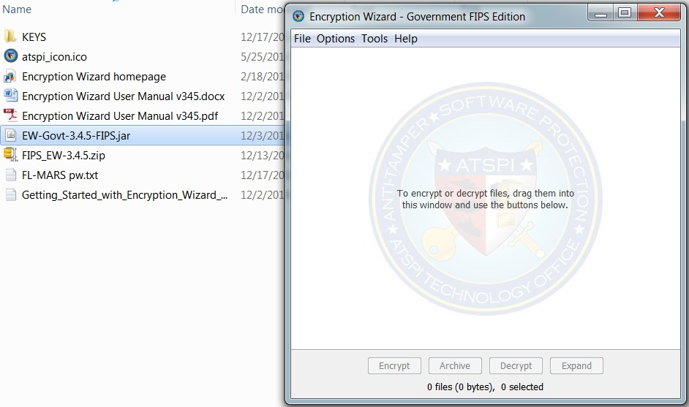
To open EW double click the EW.jar file

Slide 5
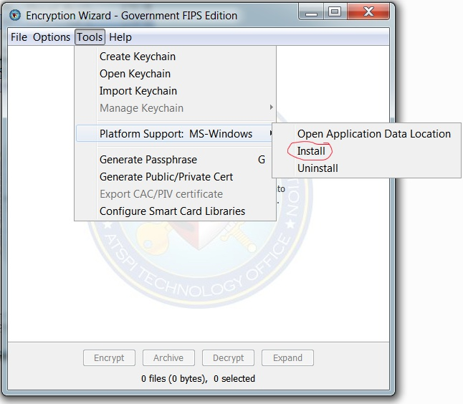
Then go to tools, platform support & click install.
This allows you to simply double click any WZA, WZD
File and it will open automatically in EW and the decrypted file will be put back to the originating folder. You may also want to put a shortcut on your desktop
You are now ready to use Encryption Wizard

