Slide 1
Click to advance

Slide 2
ENCRYPTION WIZARD
ARCHIVE
By AFA4II

Slide 3
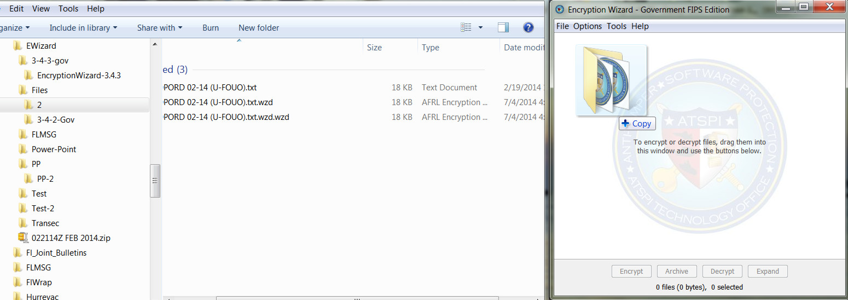
What is Encryption Wizard Archive?
What does it do? How do I use it?
Archive is a very useful tool whether you use it to send encrypted files/folders
Or to encrypt files on your hard drive or flash drive.
Archive can take 2,3,4 or 100 individual files, a complete folder or flash drive
and convert them into one encrypted .WZA archive file.
Start by dragging and dropping 2 or more files or as in the case of this tutorial
A complete folder into EWizard

Slide 4
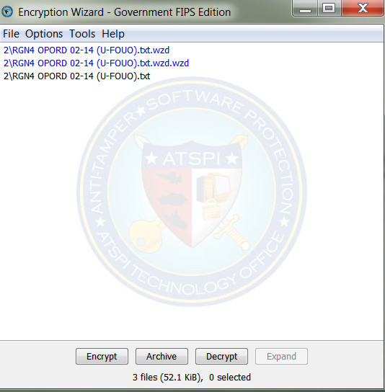
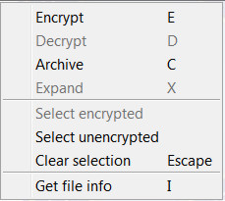
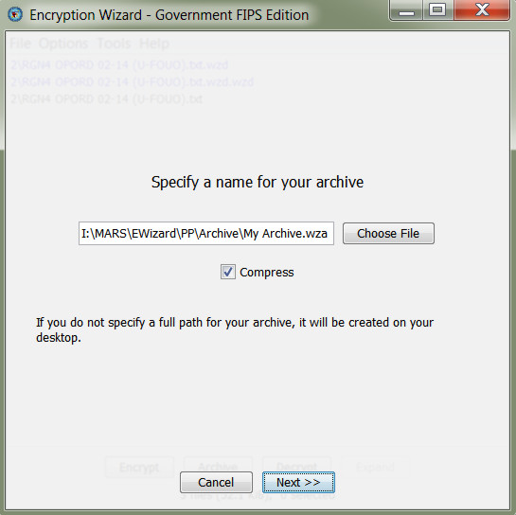
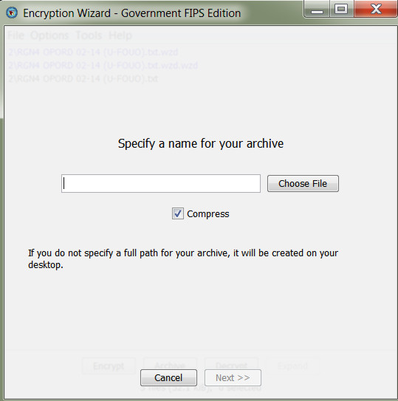
You will see all of the files that are in the folder, but not the folder itself
select all the files
By right clicking, then “select unencrypted”.
Then click Archive
Next you have to name your archive & choose a location to save it,
If no location is selected the file will be saved to the desk top.
Put a check in compress,
Then click NEXT

Slide 5
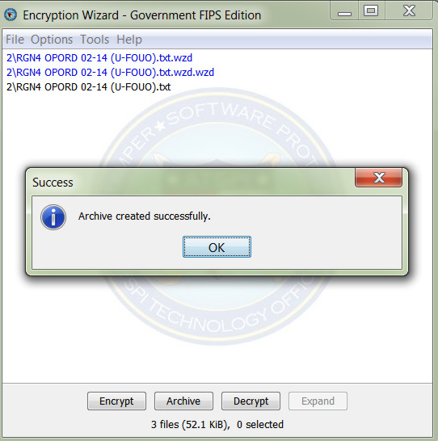
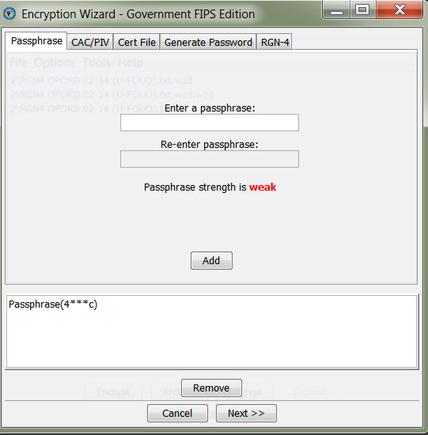
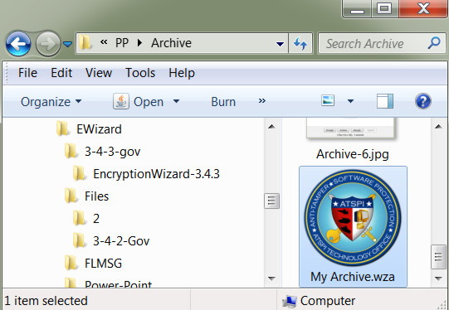
Your archive is created
FIG 2
Add the passphrase for your archive & click ADD.
Then click NEXT
FIG 1
….
….
FIG 3
And saved in chosen location.
NOTICE that it is not a .WZD file
BUT a .WZA file and a WZA file cannot be DECRYPTED,
It has to be EXPANDED

Slide 6
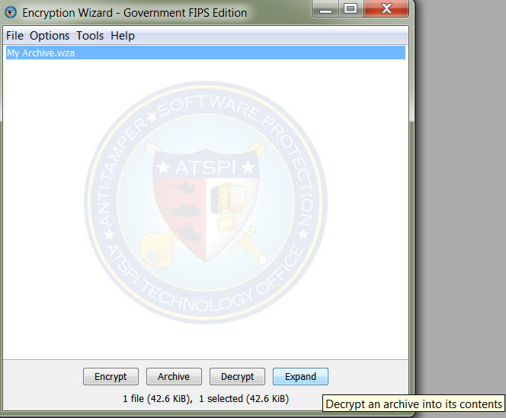
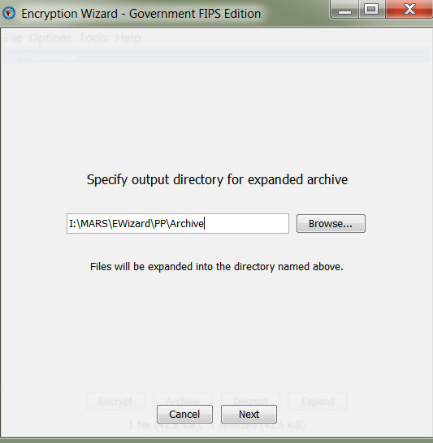
HOW TO OPEN A .WZA ARCHIVE FILE
To open an archive file you click EXPAND
Browse to the directory where you want your expanded files/folder.
Then click NEXT

Slide 7
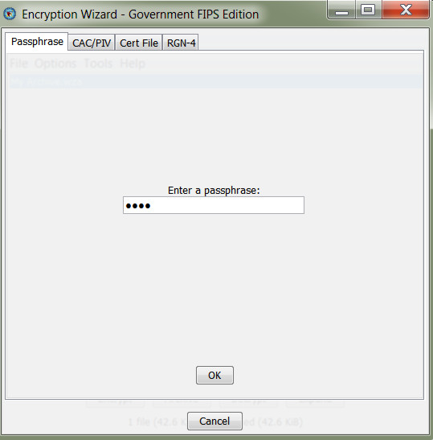
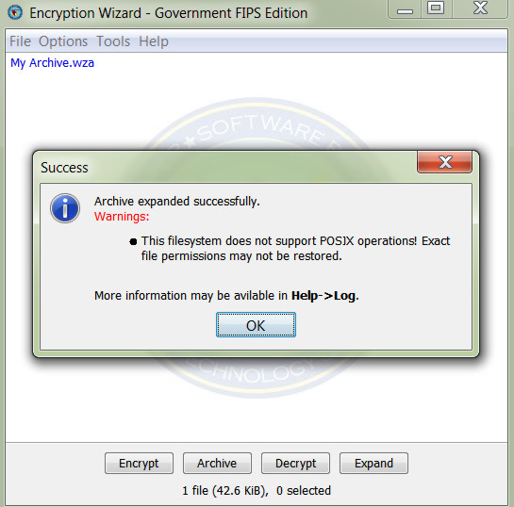
Insert your passphrase
&
Click OK
Your files/folder is expanded

Slide 8
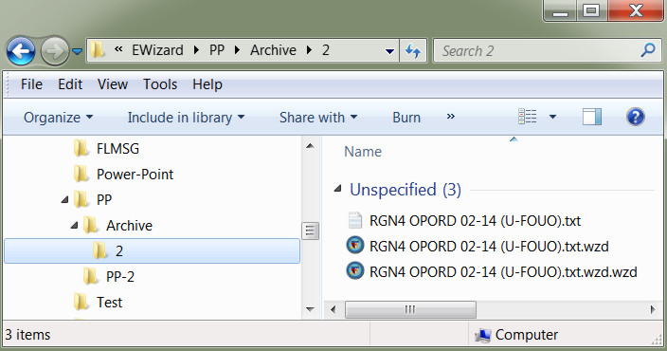
Your folder is restored along with its
contents
Expanded folder & files
Original folder & files

